Slide 1

Town Hall Meeting

Slide 2
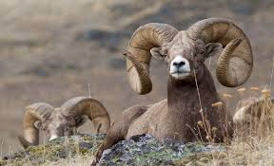
Town of Ridgeview
Bighorn sheep lived near the town many years ago.
As population of town increased, the sheep’s population was reduced.
Diseases brought in by domesticated animals reduced the herd size to just a few animals, of which various other factors, including predation, took its toll and the sheep eventually all disappeared.

Slide 3
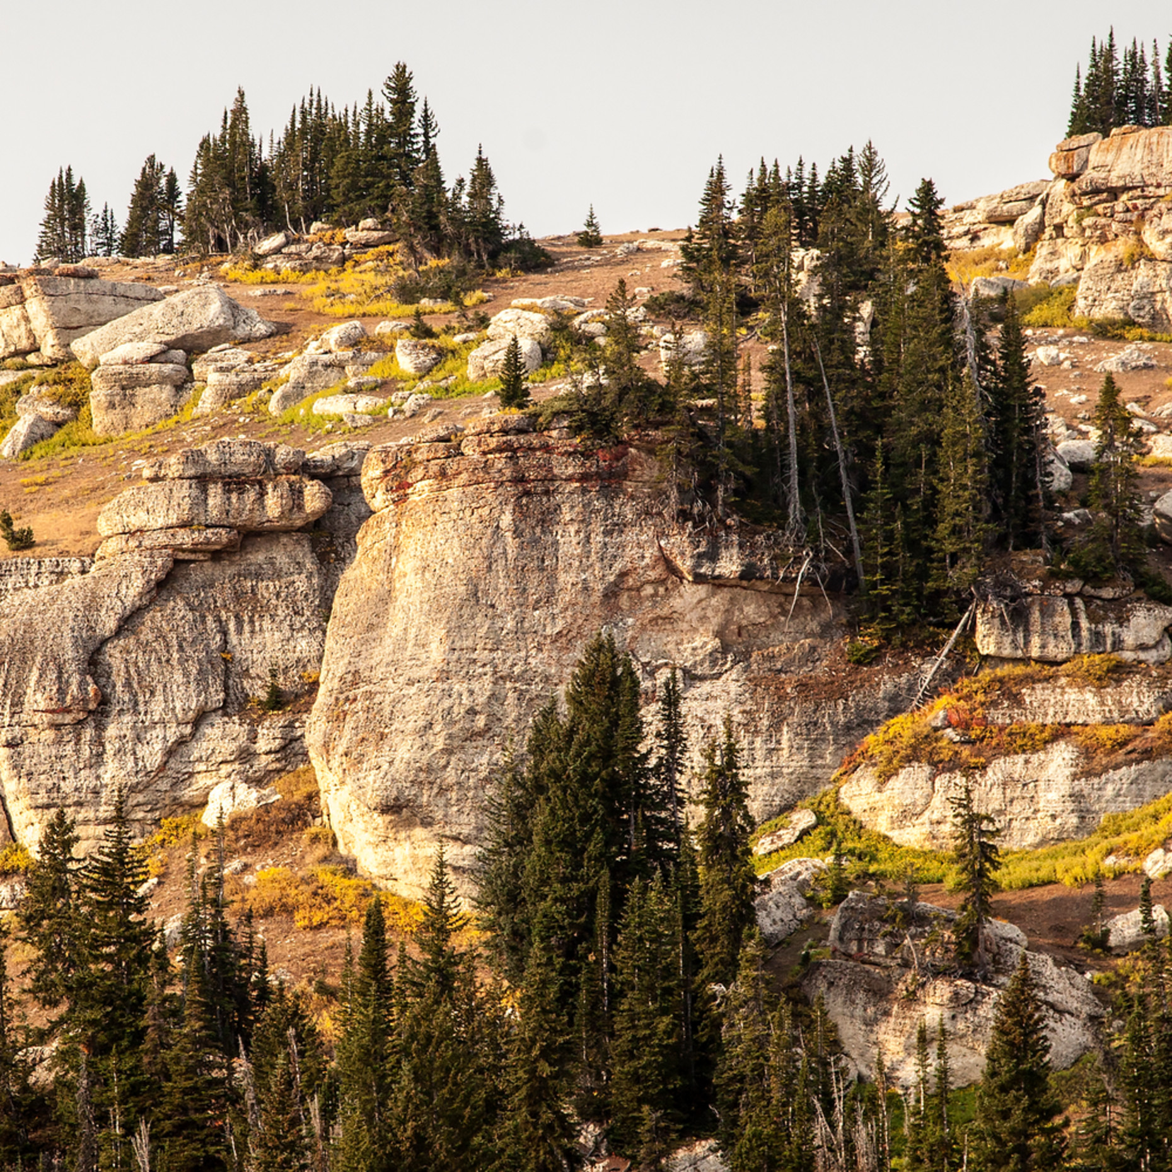
Reintroduction?
A citizen’s group wants to reintroduce a small herd of bighorn into the cliff area outside of town.
This citizen’s group includes:
Land developers
Camping outfitter
Motel owners
Hunters
Some homeowners
The mayor

Slide 4

Opposition
Opposition to the proposal of reintroducing sheep near the town sprang up within days.
Those who object:
Ranchers
Farmers
Off-road vehicle riders
Some dog owners
Some hikers
Commuters
Some homeowners

Slide 5

Tempers Flare
Each side is very passionate but has agreed to listen to the other’s position in a town meeting.
Experts have been invited by both sides to provide information on the suitability of modern-day Ridgeview as bighorn sheep habitat:
Highway commissioner
Local wildlife officer
Native American tribal leader
Bighorn sheep biologist

Slide 6
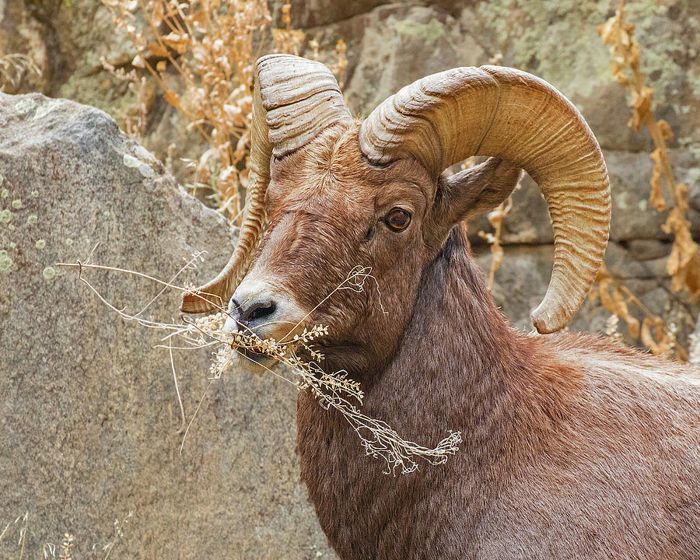
Experts Will Discuss
The effects that reintroducing the bighorn into the area would have on the local economy and whether or not the local habitat will ensure the survival of the herd.
They will consider questions of summer and winter ranges, and the numbers of bighorn the land might support.

Slide 7
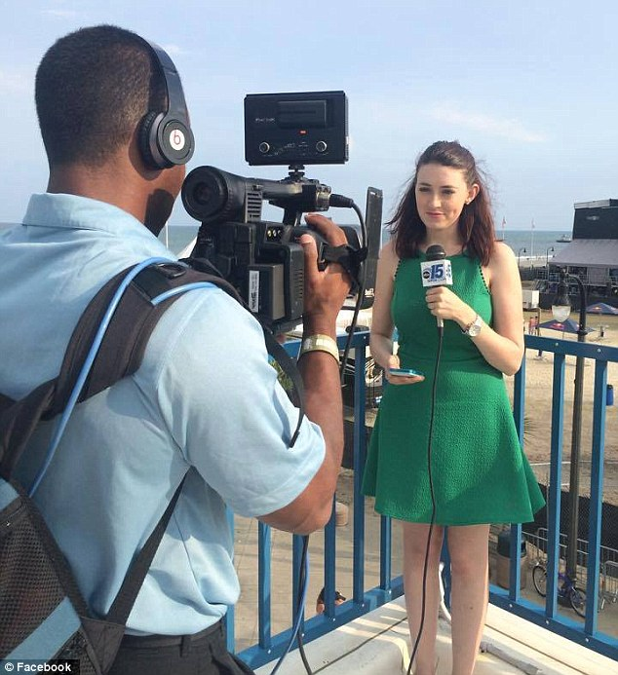
Meeting Promises to be Lively
Radio announcer
Television reporter
Newspaper reporter
Internet Blogger

Slide 8
Your Role
You will choose the role you want to play at the town hall meeting.
We need to cover all the positions though, so start thinking of which category you want to be in:
Pro Group (supports the reintroduction of the sheep)
Con Group (opposed to reintroducing the bighorn near town)
Expert (experienced in the field)
Media (Will record people’s opinions. May have your own opinion, but their job is to record other’s opinions and report them to the public in an UNBIASED fashion) WE WILL NOT BE CHOOSING ROLES HERE TODAY

Slide 9
Your Task Today:
Choose your role, after discussing with your group (Pro Group, Con Group, Expert Group)
Every role needs to be covered…so compromise and work it out. Remember, you are all on the same “team”.
Research your roles:
Work with your interest group to identify the group’s attitude toward bighorn sheep.
List problems/benefits of the reintroduction of bighorn (be ready to defend possible items the other side brings up)
Strengthen your arguments with facts such as quotes from bighorn experts, statistics, research data.
Use props such as graphs, illustrations, maps, or short video to reinforce your position.
Hold Town Hall Meeting next time we meet.

Slide 10
Begin
Research your roles:
Work with your interest group to identify the group’s attitude toward bighorn sheep.
List problems/benefits of the reintroduction of bighorn (be ready to defend possible items the other side brings up)
Strengthen your arguments with facts such as quotes from bighorn experts, statistics, research data.
Use props such as graphs, illustrations, maps, or short video to reinforce your position.

Slide 11
After the Town Hall Meeting: Optional
Watch the short film Wild & Wool, a 20-minute film from 2020 which shows perspectives of domestic sheep ranchers and wild sheep biologists.
https://www.youtube.com/watch?v=KbZU36U49Cc

